Slide 1
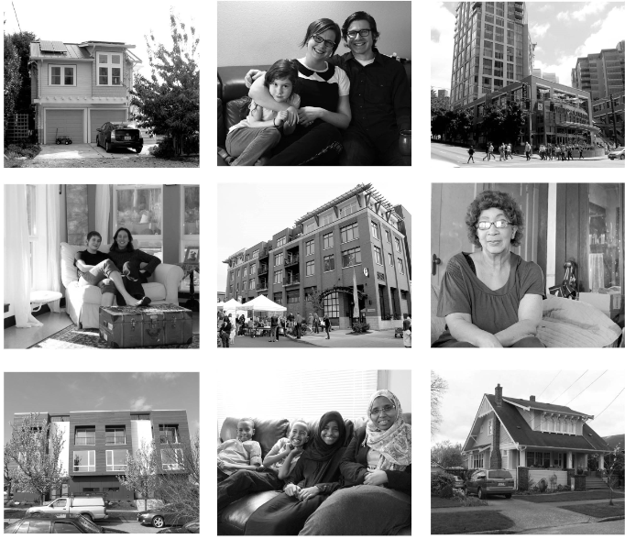
Mandatory Housing Affordability through Commercial Development
Chris Gregorich & Leslie Brinson Price, Mayor’s Office
Brennon Staley, Dept. of Planning and Development
Lindsay Masters, Office of Housing
September 18, 2015

Slide 2
Grand Bargain Agreement
Mandatory Housing Affordability (MHA) Programs
Commercial Development
Residential Development
Affordable Housing Impact Mitigation
(formerly Commercial Linkage Fee)
Mandatory Inclusionary Housing
MHA - Commercial
MHA - Residential

Slide 3
Principles of the Agreement
Two Mandatory Housing Affordability (MHA) programs for new development:
MHA – Residential
MHA – Commercial
Sets requirements based on a commitment to produce 6,000 units at 60% AMI through both programs
Increase development's contribution to affordable housing
Tie new mandatory required contributions to increases in development capacity
Modify requirements if new development capacity cannot be fully utilized
Create a stable and predictable program
Mandatory Inclusionary Zoning and Affordable Housing Impact Mitigation Implementation Resolution
MHA - Commercial Ordinance
(Affordable Housing Impact Mitigation)
Fall 2015
MHA - Residential Ordinance
(Mandatory Inclusionary Housing)
Early 2016
Zoning changes to activate both programs – 2016 - 2017

Slide 4
50,000 Homes in 10 years
30,000 Market-Rate Homes
20,000 Affordable Homes

Slide 5
MHA – Commercial Program
(Affordable Housing Impact Mitigation)

Slide 6
Mandatory Housing Affordability in Commercial Development (MHA – Commercial)
New commercial development pays a mitigation fee by the square foot
Affordable housing mitigation is required for the entire development not just the “base”.
The amount of allowed commercial development is increased by about 1 Floor Area Ratio (FAR) in Downtown/SLU and about one story in other locations.
Payment to OH will be strategically invested in affordable housing across the city
Rental Housing ≤ 60% AMI
Ownership housing ≤ 80% AMI
Alternative to provide onsite or offsite rental housing at ≤ 60% AMI for 50 years
Developments are subject to the greater of Affordable Housing Impact Mitigation Program or Incentive Zoning requirements

Slide 7
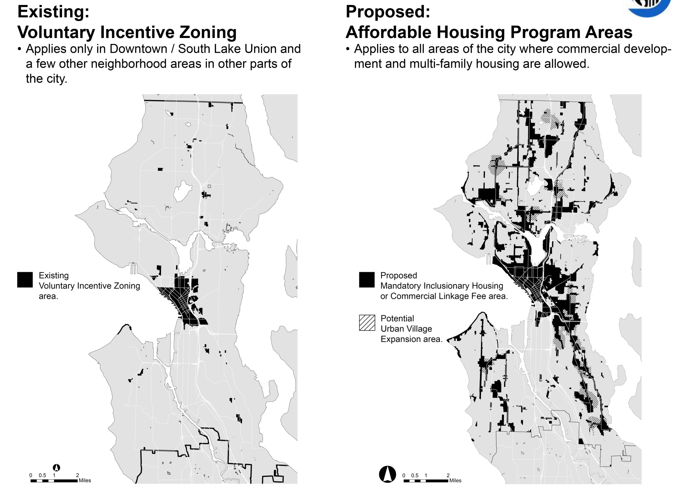

Slide 8
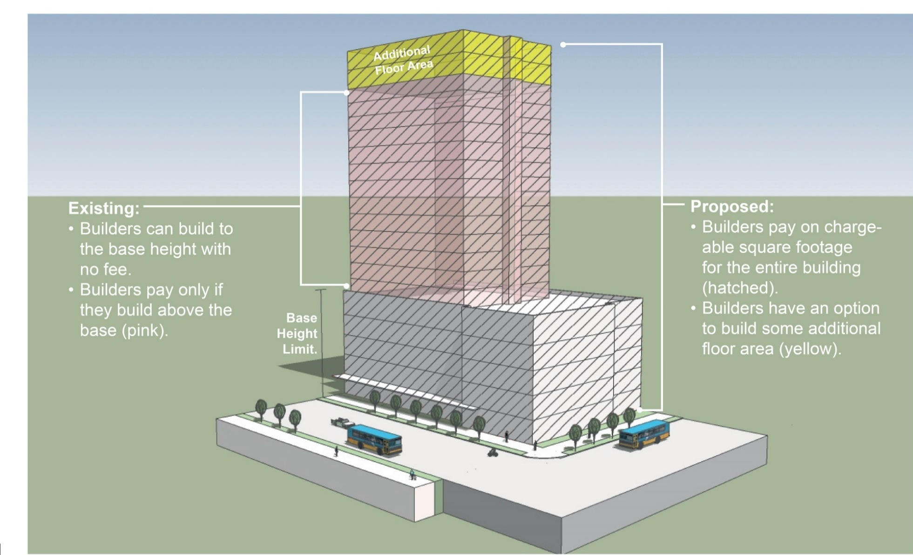
How MHA – Commercial works:
Downtown / SLU
(gray).
floor area or height (yellow).

Slide 9
MHA – Commercial
Setting of Mitigation Payment – Downtown / SLU
Downtown / SLU fees range from $8 to $17.50 depending on zone
Consistent methodology across Downtown/SLU based on agreement for programs to produce 6,000 units at 60% AMI
Maintains amount of Incentive Zoning payment
Adds higher payment amount for new capacity added
Spreads payment across the square footage of the entire building
Minimum of $8 / gross square foot (gsf)
Results in an overall increase in a development’s contribution to affordable housing
Different mitigation amount by zone because existing IZ program differs in bonus FAR by zone
Developments are subject to the greater of Affordable Housing Impact Mitigation Program or Incentive Zoning requirements
Fee is $0 in zones where no additional development capacity will be granted
Pike Place Market
Downtown Harborfront 1 (DH-1)
SLU Lakefront Blocks
Master Planned Community – Yesler Terrace

Slide 10
MHA – Commercial - Mitigation Payment Downtown and South Lake Union Urban Centers
Zone | $/gsf | Zone | $/gsf
All DH1 zones | $0.00 | All IDM zones | $8.00
DH2/55 | $14.25 | IDR 45/125-240 | $10.00
DH2/65 | $15.00 | IDR 150 | $10.00
DH2/85 | $15.25 | IDR/C 125/150-240 | $8.00
DMC-65 | $8.25 | PMM-85 | $0.00
DMC-85 | $8.00 | PSM 100/100-120 | $11.00
DMC 85/65-150 | $11.75 | PSM 100/100-130 | $11.00
DMC-125 | $10.00 | PSM 100/120-150 | $11.00
DMC-160 | $8.00 | PSM-100 | $11.00
DMC 240/290-400 | $10.00 | PSM-245 | $10.25
DMC 340/290-400 | $12.50 | PSM-85-120 | $12.25
DOC1 U/450/U | $14.75 | SM 85/65-125 | $8.00
DOC2 500/300-500 | $14.25 | SM 85/65-160 | $0.00
DRC 85-150 | $13.50 | SM 85-240 | $0.00
DMR/C 65/65-85 | $9.75 | SM 160/85-240 | $11.25
DMR/C 65/65-150 | $9.75 | SM 240/125-400 | $10.00
DMR/C 85/65 | $17.50 | SM/R 55/85 | $8.25
DMR/C 125/65 | $17.50 | SM-85 | $8.00
DMR/C 240/125 | $14.25 | SM-125 | $8.00
DMR/R 85/65 | $14.00 | IC-45 | $8.00
DMR/R 125/65 | $16.00 | IC-65 | $8.00
DMR/R 240/65 | $16.00 | C2-40 | $0.00

Slide 11
How MHA – Commercial works:
Outside Downtown / SLU with Limited Existing Incentive Zoning
and the Impact Mitigation fee is paid on all square footage in the building (hatched).

Slide 12
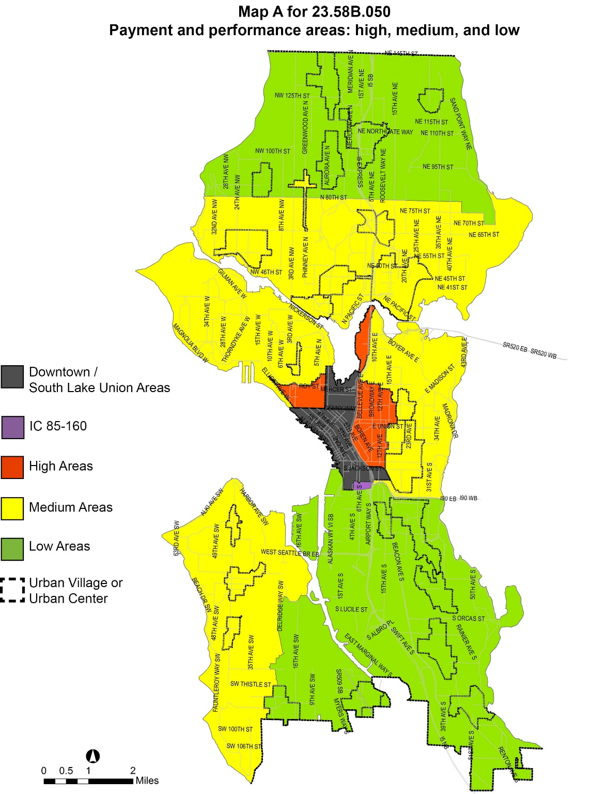
MHA – Commercial
Setting of Mitigation Amount
Outside Downtown / SLU
Varies by geographic areas
$5/ gsf in low cost markets
$7/ gsf in medium cost markets
$8/ gsf in higher cost markets
$10 / gsf in IC 85-60
Areas delineated based on average rental rates

Slide 13
MHA – Commercial
Scope and Applicability
Applies to developments with > 4,000 square feet of new chargeable floor area devoted to commercial uses
Does not apply to institutional uses, but does apply to an institution building a commercial use.
Continued priority to activate the street in primarily residential buildings
Exemption for first 4,000 sf of street-level retail
Exemption for all required street-level retail on pedestrian designated streets
Does not apply to
Residential zones (LR, MR, HR, RSL, SF)
Industrial zones (IB, IG)
Master Planned Community – Yesler Terrace (MPC-YT) zone
Zones where no increase in capacity is contemplated (DH1, PMM, SLU lakefront blocks)

Slide 14
MHA - Commercial
Activating the Program
Program is linked to providing additional development capacity through zoning changes and is activated when the program (Chapter 23.58B) is specifically referred to within the provisions of a zone
Reference to 23.58B will be added when
Land Use Code or Land Use Map amendments are made to increase commercial development capacity
Zoning changes are sought through contract rezones
Minor deviations from Development Standards allowed within defined limits to take advantage of new additional capacity (e.g. lot coverage, setbacks, etc.)
Applicant may apply for fee reduction if it demonstrates additional capacity is still not useable even with development standard modifications.

Slide 15
MHA - Commercial
A steady and predictable program is a key component of the ‘Grand Bargain’ agreement
Initial Implementation Phase (through 2017)
May change fees in table as increases in development capacity are further refined through 2017.
May adjust fees should modeling of MHA – Commercial and Residential Programs drop below shared goal of 6,000 units
Post Implementation Review
Amendments subject to a Technical Review Committee process and considered if:
After 5 years, there is a failure to meet expectations of program performance
Significant positive or negative changes in the real estate market
Neither of above, but 10 years has passed since implementation of program

Slide 16
Legislation Schedule for activating Mandatory Affordable Housing Programs
Legislation Schedule
Fall 2015 | MHA – Commercial Framework Ordinance
Q1 2016 | MHA – Residential Framework Ordinance
Q2 2016 | Zoning changes in Downtown, South Lake Union and 23rd Avenue
Q2 2016 | University District Zoning Changes
Q3 2016 | Seattle 2035 and consideration of Urban Village boundary changes
Q3 2016 | Zoning changes in coordination with Uptown and Rainier Beach area planning
Q2 2017 | Zone-wide changes to Commercial and Neighborhood Commercial, Multifamily zones, and single family areas in urban villages.
Ongoing Community Outreach and Engagement

Slide 17
Examples of Potential Zoning Changes to activate Mandatory Housing Affordability programs

Slide 18
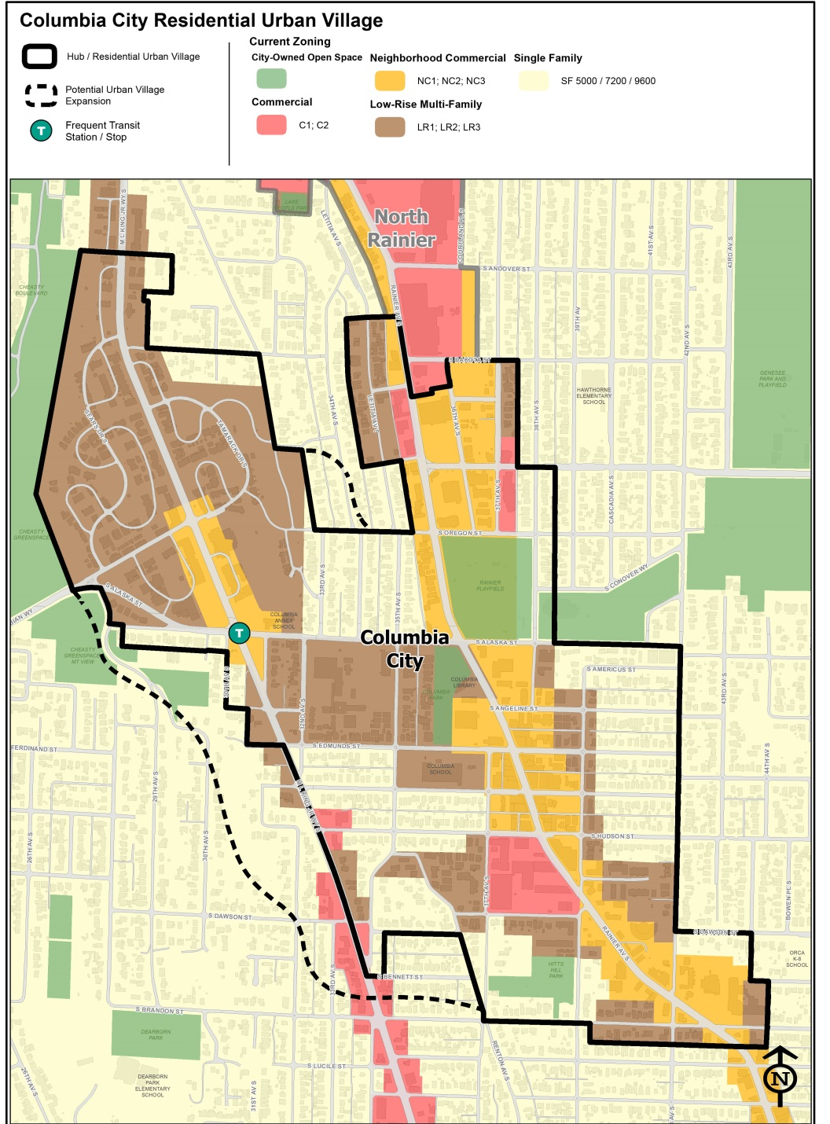
Example of Potential Zoning Changes
in an Urban Village to activate Mandatory Housing Affordability Programs
Existing Lowrise Multifamily Zoning
Increase amount of FAR, allowable density, or 1 extra story of height.
Existing Lowrise Neighborhood Commercial Zoning
Increase amount of FAR and 1 extra story of height.
.
SF Zoning Already Within Urban Village
Change to Lowrise, Residential Small Lot (RSL) zoning, or Midrise (MR) depending on neighborhood context.
SF Zoning Within Transit Walkshed
Evaluate change to Residential Small Lot (RSL) or Lowrise.
SF Zoning Other Areas
No change.

Slide 19
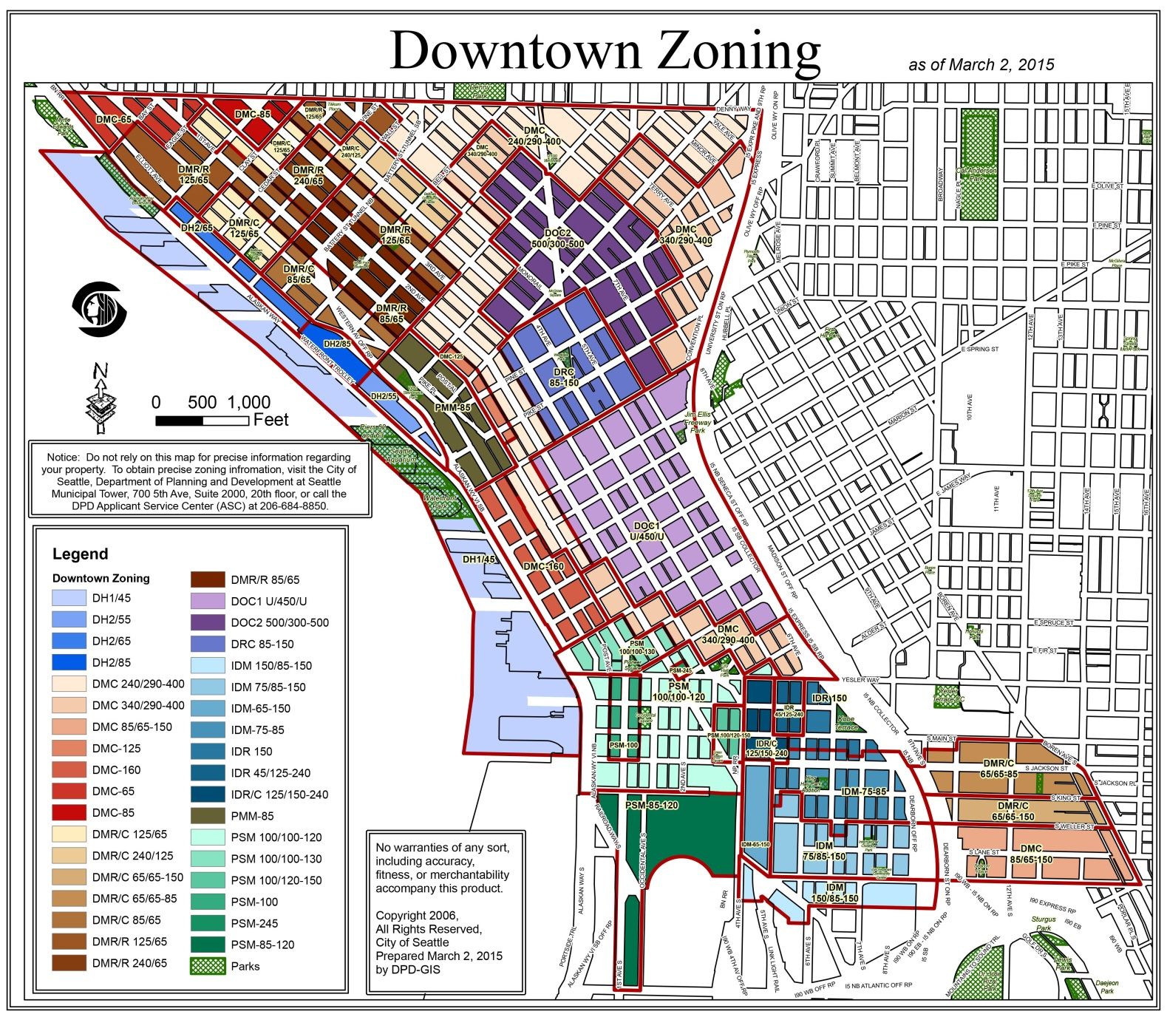
Example of Potential Zoning Changes
in Downtown / SLU to Activate Mandatory Housing Affordability Programs
Most Downtown Zones
Increase allowed FAR by ~1.0, or allowed residential floor plate size by 1,000 sq. ft.
Some Constrained Zones
No increase in commercial capacity. Examples: Harborfront zones, Pike Market Mixed, SLU Lakefront blocks
.

